Slide 1
HTML
Lab 15: Basic HTML (HTML heading, Paragraph, Text formatting)

Slide 2


Welcome to HTML Class

Slide 3

HTML Heading
Headings are defined with
the <h1> to <h6> tags.
<h1> defines the most important heading. <h6> defines the least important heading.
<h1> Heading 1 </h1>
<h2> Heading 2 </h2>
<h3> Heading 3 </h3>
<h4> Heading 4 </h4>
<h5> Heading 5 </h5>
<h6> Heading 6 </h6>

Slide 4
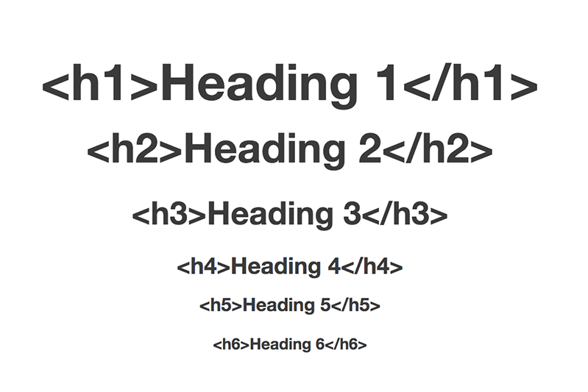
Heading Example

Slide 5
HTML paragraph
The HTML <p> element defines a paragraph:
<p>This is a paragraph.</p>
<p>This is another paragraph.</p>

Slide 6
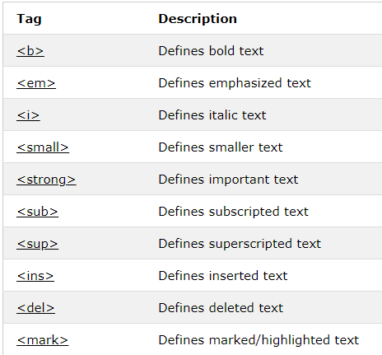
HTML Text Formatting Elements

Slide 7
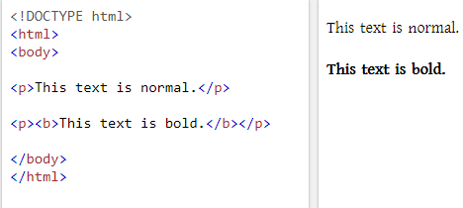
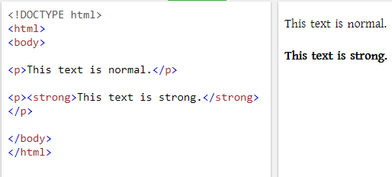
Text Formatting: Bold & Strong

Slide 8
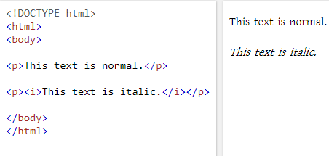
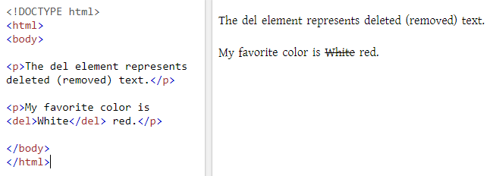
Text Formatting: Italic & Deleted

Slide 9
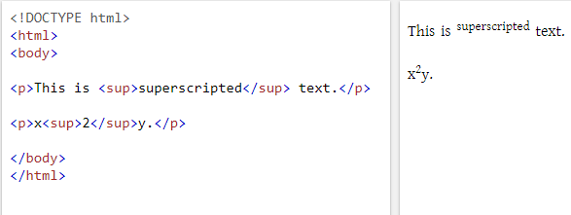
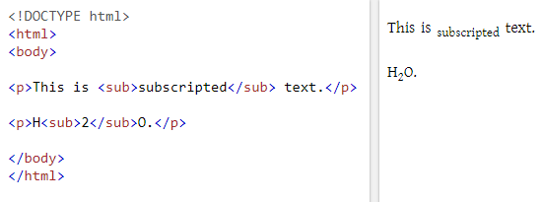
Text Formatting: Sup & Subscript

Slide 10

Today’s learning:
HTML Heading (h1…h6)
HTML Paragraph(p)
Text Formatting
Thank You!

